Slide 1
DIABETES PREDICTION USING MACHINE LEARNING
SRUTHI S
2019506098

Slide 2
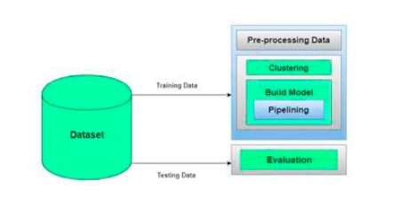
1. Diabetes Prediction using Machine Learning Algorithms
Aishwarya,Dr. Vaidehi. Published by Elsevier B.V 2019
PURPOSE
To improve the accuracy and for better classification of diabetes by including few external factors
METHODS USED
Dataset collection,
Data Pre-processing,
Clustering,
Build Model,
Evaluation.
ML ALGORITHM USED
Random Forest Classifier, Decision Tree Classifier, Extra Tree Classifier, Ada Boost algorithm, Perceptron, Linear Discriminant Analysis algorithm, Logistic Regression, K-Nearest Neighbour, Gaussian Naïve Bayes, Bagging algorithm, Gradient Boost Classifier.

Slide 3
EVALUATION METRICS
Classification accuracy, confusion matrix, F1 score.
ACCURACY
Logistic Regression gives highest accuracy of 96%.
ADVANTAGE
Classification accuracy is boosted with new dataset compared with existing dataset.
For better classification we include few external factors that is responsible for diabetes.
DISADVANTAGE
One of the limitation is the size of the dataset and missing values of data.

Slide 4
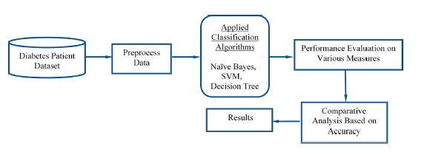
2. Prediction of Diabetes using Classification Algorithms. Deepti Sisodia, Dilip Singh Sisodia Published by Elsevier B.V 2018
PURPOSE
To design a model which can prognosticate the likelihood of diabetes in patients with maximum accuracy
METHODS USED
Data collection & preprocessing,
Classification,
Performance evaluation,
Comparision .
ML ALGORITHM USED
Decision tree, Support Vector Machine and Naïve Bayes

Slide 5
EVALUATION METRICS
Precision, Accuracy,Recall, F-measure and ROC.
ACCURACY
Naïve Bayes gives highest accuracy of 76.30%.
ADVANTAGE
Naïve Bayes ML classifier can predict the chances of diabetes with more accuracy compared to other classifiers.
DISADVANTAGE
One of the limitation is the size of the dataset and missing values of data.

Slide 6
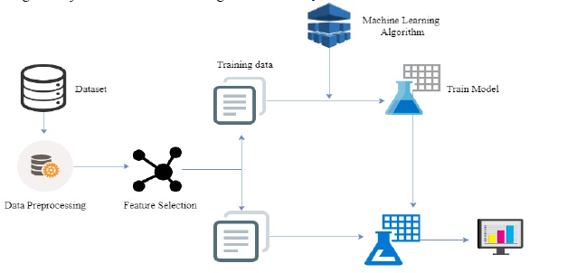
3. Prediction of Diabetes Using Machine Learning Algorithms in Healthcare
Muhammad Azeem Sarwar et al Published by IEEE 2018
PURPOSE
To help doctors and practitioners in early prediction of diabetes using machine learning techniques.
METHODS USED
Data collection,
Pre- processing,
Feature selection,
Training and testing the data,
Evaluation.
ML ALGORITHM USED
k-Nearest Neighbours, Naïve Bayes, Support Vector machine, Decision Tree, Logistic Regression and Random Forest..

Slide 7
EVALUATION METRICS
Accuracy.
ACCURACY
SVM and KNN gives highest accuracy of 77%.
ADVANTAGE
Performance and accuracy of different algorithm is compared to identify best suited algorithm for diabetes prediction.
DISADVANTAGE
One of the limitation is the size of the dataset and missing values of data.

Slide 8
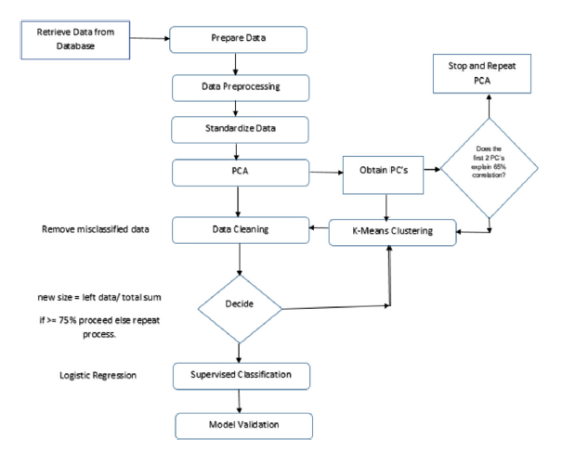
4. Improved logistic regression model for diabetes prediction by integrating PCA and K-means techniques
Changsheng Zhu et al Published by Elsevier B.V 2019
PURPOSE
To develop a model for early diagnosis and prediction of diabetes by intergrating PCA and K means clustering.
METHODS USED
Data description,
Pre-processing dataset,
Performing PCA,
Clustering,
Classification,
Evaluate model output.
ML ALGORITHM USED
K-means clustering, Logistic regression

Slide 9
EVALUATION METRICS
Confusion matrix, Recall, Precision, Accuracy,MCC.
ACCURACY
By applying PCA , K-means and logistic regression we get 97.40% accuracy.
ADVANTAGE
Logistic regression model with improved accuracy by intergrating PCA and K-means. Ability to model a new dataset successfully with 89% accuracy.
DISADVANTAGE
One of the limitation is the size of the dataset and missing values of data.

Slide 10
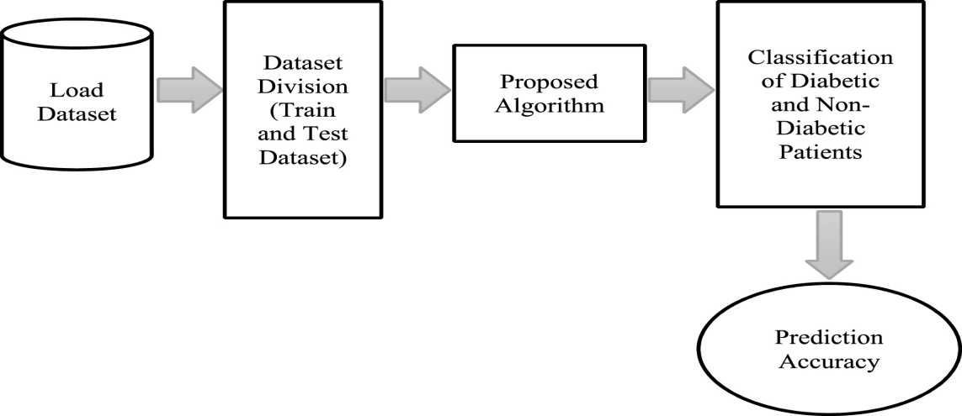
5. Performance Analysis of Classifier Models to Predict Diabetes Mellitus
J. Pradeep Kandhasamy, S.Balamurali Published by Elsevier B.V 2015
PURPOSE
To compare the performance of different algorithms which are used to predict diabetes.
METHODS USED
Data preparation,
Pre-processing,
Classification,
Evaluation.
ML ALGORITHM USED
Decision Tree J48, K Nearest Neighbor classifier, Random Forest, Support Vector Machine.

Slide 11
EVALUATION METRICS
Accuracy, Specificity, Sensitivity.
ACCURACY
After pre-processing KNN(k=1) and Random Forest gives highest accuracy of 100%.
ADVANTAGE
It is tested with both noisy data and noiseless data. Further its is compared in terms of accuracy, sensitivity and specificity.
DISADVANTAGE
One of the limitation is the size of the dataset and missing values of data.

Slide 12
CONCLUSION
Proper dataset is very important.
Missing values, duplicate values should be removed to improve the accuracy of the model.
Feature selection is used to reduce the number of attributes which can avoid redundant features.
For model validation we use K fold cross validation.
Different Machine learning classification algorithm gives different accuracy measure. So it is important to carefully select the algorithm.
And at last we have different evaluation metrics to evaluate the correctness of the prediction made by the model.

